Slide 1
Red-Black tree
Recall binary search tree
  Key values in the left subtree <= the node value
  Key values in the right subtree >= the node value
Operations:
  insertion, deletion
  Search, maximum, minimum, successor, predecessor.
  O(h), h is the height of the tree.

Slide 2
Red-black trees
Definition: a binary tree, satisfying:
  Every node is red or black
  The root is black
  Every leaf is NIL and is black
  If a node is red, then both its children are black
  For each node, all paths from the node to descendant leaves contain the same number of black nodes.
Purpose: keep the tree balanced.
Other balanced search tree:
  AVL tree, 2-3-4 tree, Splay tree, Treap

Slide 3
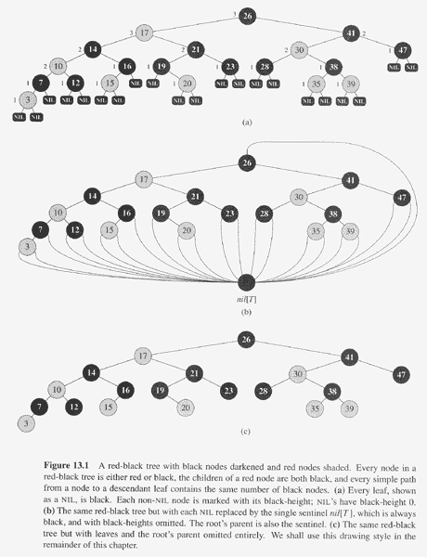
Copyright © The McGraw-Hill Companies, Inc. Permission required for reproduction or display.

Slide 4
Fields and property
Left, right, ,parent, color, key
bh(x), black-height of x, the number of black nodes on any path from x (excluding x) to a leaf.
A red-black tree with n internal nodes has height at most 2log(n+1).
  Note: internal nodes: all normal key-bearing nodes. External nodes: Nil nodes or the Nil Sentinel.
  A subtree rooted at x contains at least 2^{bh(x)}-1 internal nodes.
  By property 4, bh(root)≥h/2.
  n ≥ 2^{h/2}-1

Slide 5
Some operations in log(n)
Search, minimum, maximum, successor, predecessor.
Let us discuss insert or delete.

Slide 6
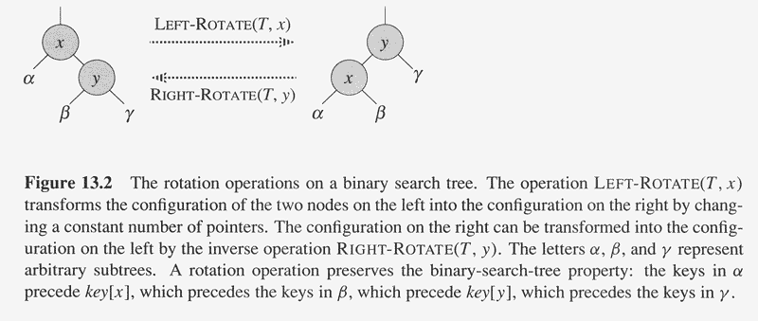
Copyright © The McGraw-Hill Companies, Inc. Permission required for reproduction or display.
Right rotation:
x=left[y]; left[y]=right[x];
If(right[x]!=nil) p[right[x]]=y;
p[x]=p[y]; if(p[y]==nil) root=x;
If(left[p[y]]=y) left[p[y]]=x;
else right[p[y]]=x;
right[x]=y; p[y]=x;
Left rotation:
y=right[x]; right[x] ←left[y]; If(left[y]!=nil) p[left[y]]=x; p[y]=p[x]; if(p[x]==nil) {root=y;} else if (left[p[x]]==x) left[p[x]]=y; else right[p[x]]=y;
left[y]=x; p[x]=y;

Slide 7
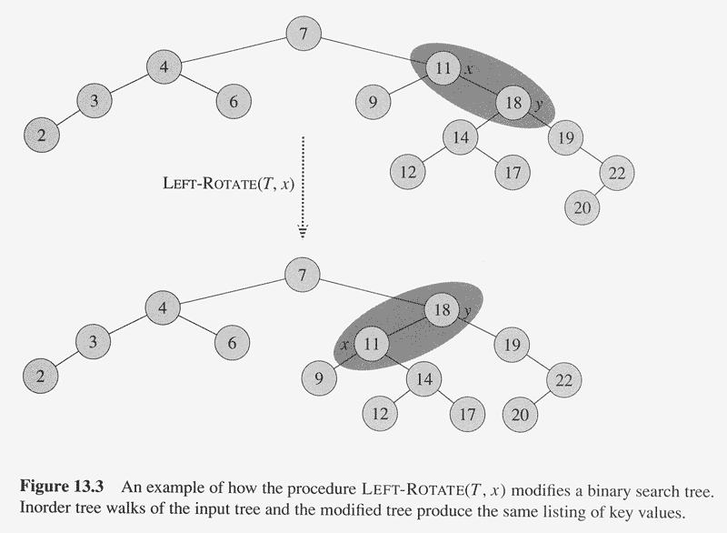
Copyright © The McGraw-Hill Companies, Inc. Permission required for reproduction or display.

Slide 8
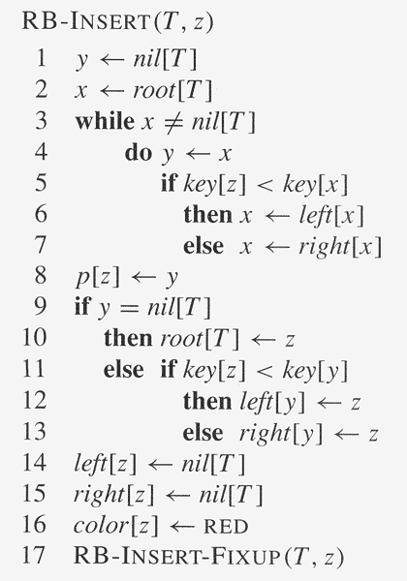
Copyright © The McGraw-Hill Companies, Inc. Permission required for reproduction or display.

Slide 9
Properties violations
Property 1 (each node black or red): hold
Proper 3: (each leaf is black sentinel): hold.
Property 5: same number of blacks: hold
Property 2: (root is black), not, if z is root (and colored red).
Property 4: (the child of a red node must be black), not, if z’s parent is red.

Slide 10
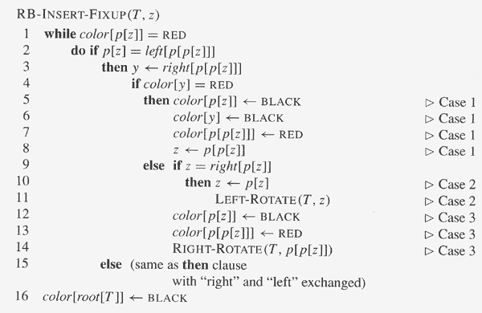
Copyright © The McGraw-Hill Companies, Inc. Permission required for reproduction or display.
Case 1,2,3: p[z] is the left child of p[p[z]].
Correspondingly, there are 3 other cases,
In which p[z] is the right child of p[p[z]]

Slide 11
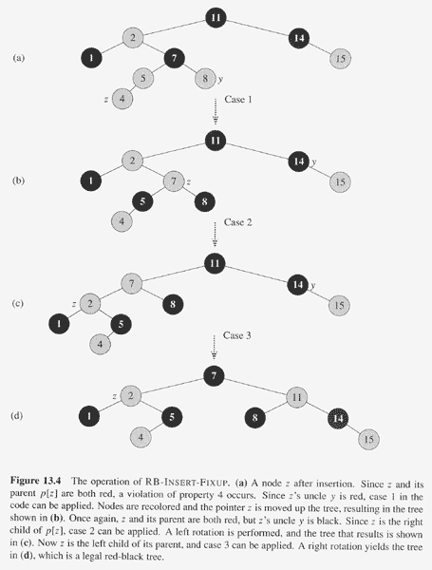
Copyright © The McGraw-Hill Companies, Inc. Permission required for reproduction or display.

Slide 12
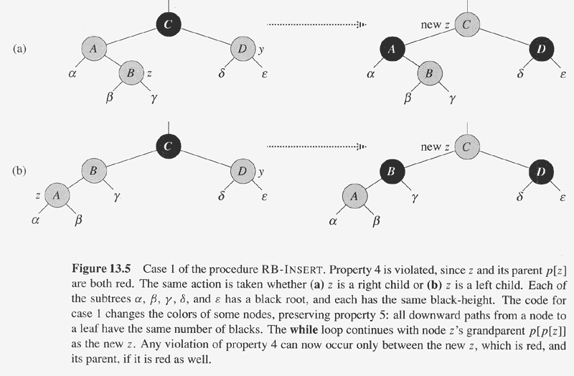
Copyright © The McGraw-Hill Companies, Inc. Permission required for reproduction or display.
case 1: z’s uncle is red.

Slide 13
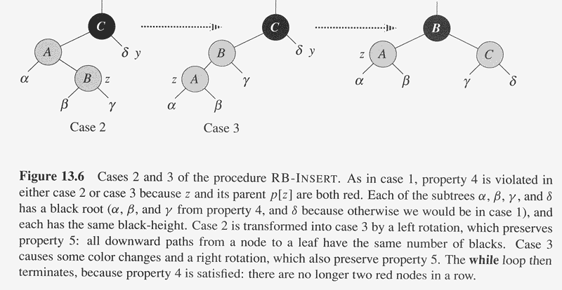
Copyright © The McGraw-Hill Companies, Inc. Permission required for reproduction or display.
Case 2: z’s uncle is black and z is a right child. Case 3: z’s uncle is black and z is a left child
What is the running time of RB_INSERT_FIX? And RB_INSERT?

Slide 14
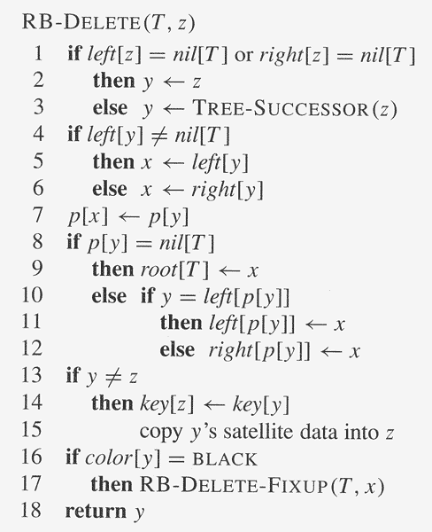
Copyright © The McGraw-Hill Companies, Inc. Permission required for reproduction or display.

Slide 15
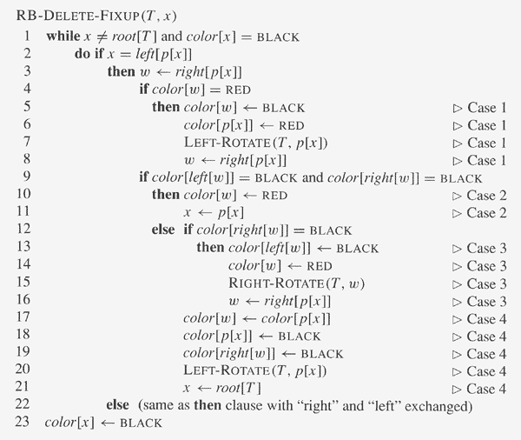
Copyright © The McGraw-Hill Companies, Inc. Permission required for reproduction or display.

Slide 16
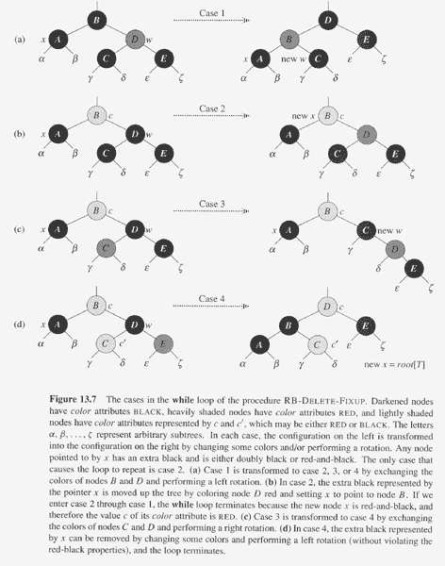
Copyright © The McGraw-Hill Companies, Inc. Permission required for reproduction or display.

